Slide 1
REALISM
1861-1914

Slide 2
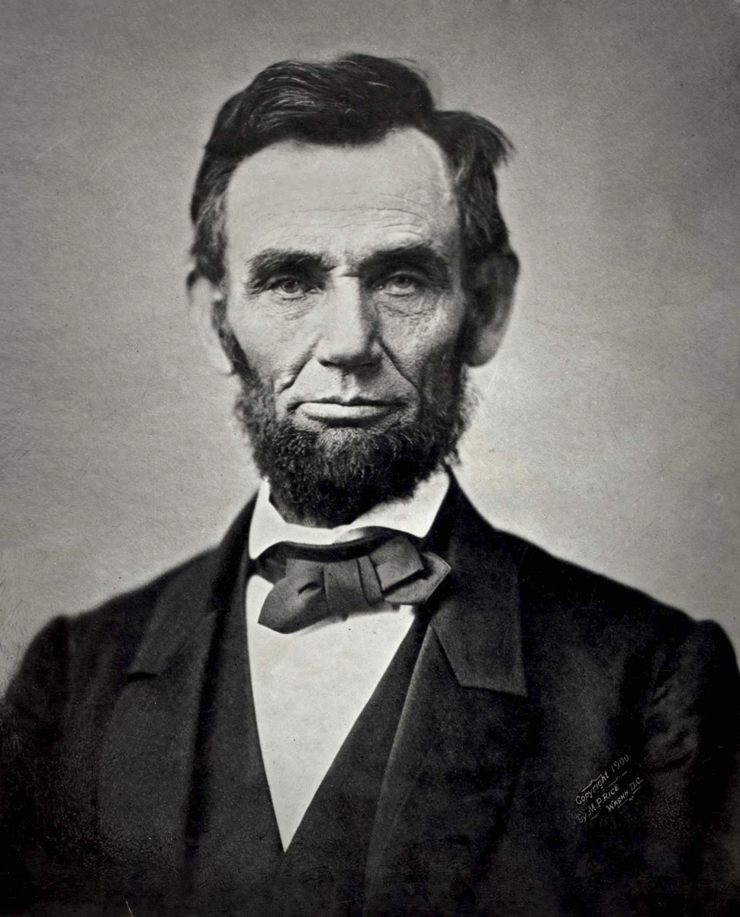
What was going on in history
Civil War
Slavery (and division among people because of differing opinions about it)
Abraham Lincoln’s assassination
Large numbers of European immigrants come to the U.S.
Important inventions (the telephone! the car! toilet paper!) that changed the way of life

Slide 3
Fundamental Ideas
Ordinary characters
Realistic events
Emphasis on characters from cities and lower classes
Not overly dramatic
Everyday speech patterns/dialect
Everyday struggles

Slide 4
Types of writing
Short stories
Autobiographies (especially slave narratives)
Novels
Poetry

Slide 5
3 Types of Realism
Basic | Regionalism | Naturalism
Bitter reaction to life after the Civil War Diminished belief in a national purpose “Slice of life” / Real people and real situations Typical subjects: cities / slums, factories, corrupt politics Character>action Addresses social questions | Makes uses of a specific geographic setting and the speech and manners of that setting Uses dialect + vivid landscape description The best regionalism transcends the region and becomes universal Sometimes humorous | Nature vs. nurture How our environment shapes us Man vs. nature Unpleasant / ugly themes Destiny = heredity, environment, physical drives, economics Feeling that people have no control over destiny

