Slide 1
Puritan Literature
Presented this 14th day of August in Puritan-appropriate black and white.
Please do not enjoy.

Slide 2
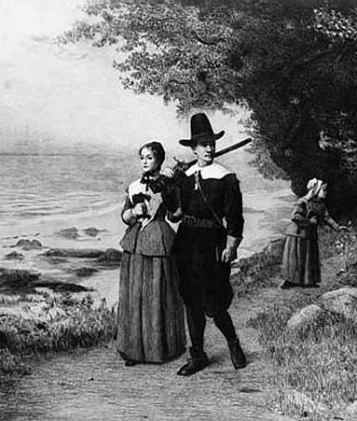
Puritans
Originated in England
Sought to purify the Church of England
Persecuted in England because of their strident beliefs
Fled England and initially relocated in Holland (but then later, America)

Slide 3
Some Puritan Terms
Theocracy – government based on the word of God
Puritan Paradox – fled England to escape persecution, yet proceeded to persecute others in the New World
Original Sin – the belief that every human is born in sin and therefore all humans are innately sinful
Predestination – the belief that God saves only a chosen few – “The Elect”; you strive to live a decent, sin-free life in order to insure your place in heaven should you be among “The Elect”
Saved by Grace –the belief that a person can be “saved” (go to Heaven) through the grace of God.

Slide 4
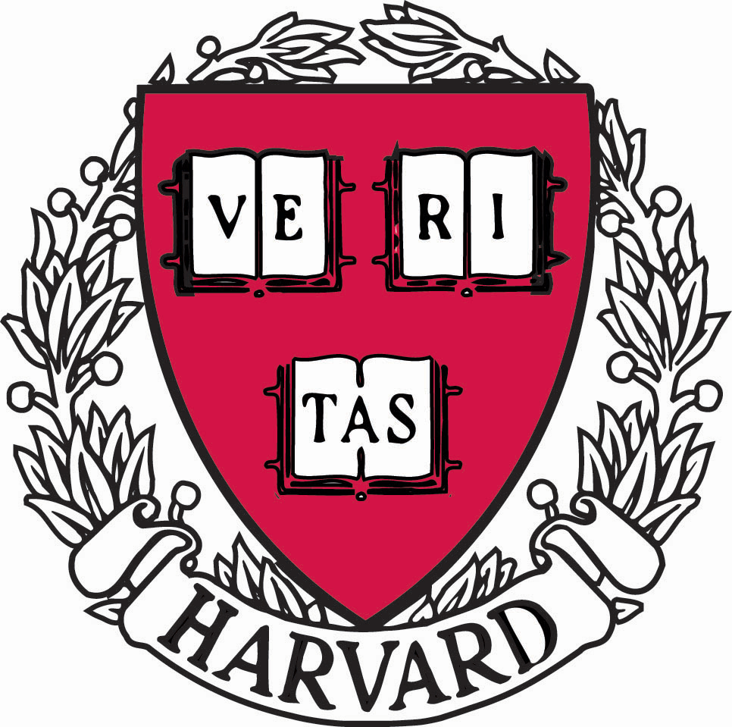
Core Puritan Values
(not necessarily bad)
Hard work
Simplicity in all aspects of life (dress, behavior, speech)
Self-reliance
Education (Puritans established Harvard College in 1636)

Slide 5
TRAITS OF WRITING
1. Simple
2. Often religious (Biblically based)
3. Very few figures of speech/literary devices (metaphors, “flowery” language)
Examples: --journals
--poems
--sermons

Slide 6
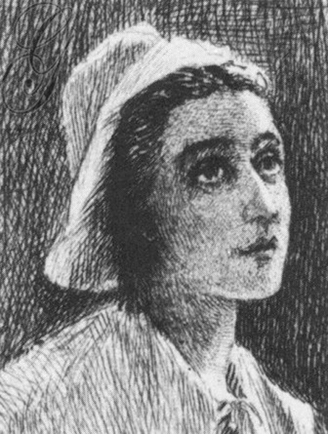
Anne Bradstreet (1612-1672)
Born into a Puritan family and, at 16, married a zealous Puritan and moved to the New World
Kept house and raised 4 boys and 4 girls
Physically weak from illness and other New World hardships
Wrote poems privately without seeking an audience or publication
Unbeknownst to her, Bradstreet’s brother-in-law took her poems to England and had them published
Many in Puritan society criticized Bradstreet for being a poet, deeming it an inappropriate craft
now called “America’s First Poet”
her work reflects her love for family, home, and daily life

Slide 7
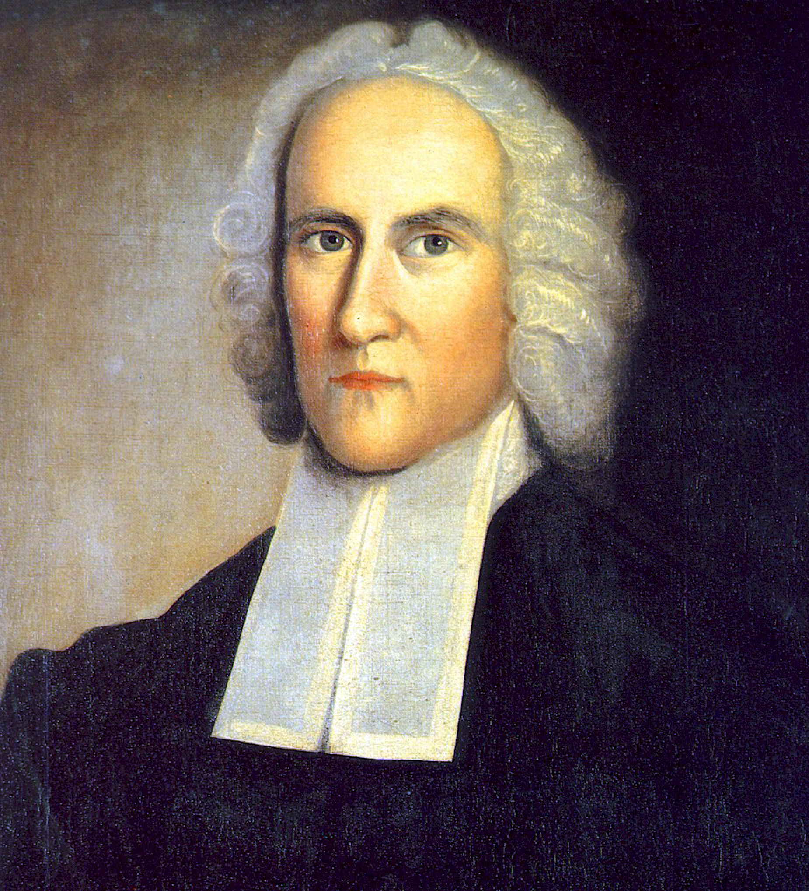
Jonathan Edwards (1703-1758)
Believe religion was an “emotional” experience
Entered what is now Yale at age of 12
Aided in converting many to Christianity
Preached nearly 1200 sermons as part of a revival movement known as “the Great Awakening” (1734-1750)
Near the end of his life, was appointed as president of what is now Princeton U.

